Slide 1

Front End Engineering-II
Project Presentation
Semester-III (Batch-2023)
PRIMETIX: Event Ticket Booking Site
Supervised By: Submitted By:
Thirupathy M Arjun Singla , 2310991787
Arshdeeep Singh , 2310991792
Arshit Kataria , 2310991793 Athrv Mahajan , 2310991038
Department of Computer Science and Engineering
Chitkara University Institute of Engineering & Technology,
Chitkara University, Punjab
:

Slide 2
Table of Contents
ABSTRACT
INTRODUCTION
PROBLEM STATEMENT
PROBLEM REQUIREMENTS
MARKET COMPETITORS
RESULTS
TIMELINE
REFERENCES

Slide 3
ABSTRACT
This presentation introduces an innovative event booking website designed to streamline the process of purchasing tickets for events, shows, and stadium matches. Our platform's user-friendly interface ensures a smooth navigation experience, making ticket booking faster and more convenient. The real-time booking system prevents cross-bookings by allowing users to view and book only available tickets. The platform also supports a wide range of event types, providing a comprehensive solution for ticket booking.

Slide 4
INTRODUCTION
Our project is structured into three key phases to ensure an effective and scalable event booking platform:
Foundation Development: The first phase focuses on implementing HTML, CSS, and basic JavaScript to establish the core structure and design of the website.
Enhanced User Interaction: The next phase involves incorporating advanced JavaScript tools to enable live user interactions, ensuring a smooth and dynamic user experience.
Modern Technology Integration: Finally, we will integrate React JS for optimized rendering using a virtual DOM.
Database Server: Along with an SQL database for efficient data management and Node.js for handling server-side operations, ensuring the platform's performance and scalability.

Slide 5
PROBLEM STATEMENT
The current event booking platforms often face issues such as website crashes during high traffic, limited payment options, and difficulties in comparing different venues. Additionally, many platforms do not offer early notifications for ticket availability, leading to missed opportunities for users.

Slide 6
PROBLEM REQUIREMENTS
Real-Time Booking System:
The system must prevent cross-bookings by allowing users to only see available tickets.
User Interface (UI) and User Experience (UX):
The platform should be easy to navigate and visually appealing.
Multiple Payment Options:
Support for various payment methods such as UPI, net banking, etc.
Scalability:
The platform must handle high traffic without crashing.
Ticket Availability Notifications:
Users should receive early notifications for ticket availability.
Diverse Event Coverage:
The platform should cover a wide range of events, including transportation services.

Slide 7
MARKET COMPETITORS
Competitors | Strengths | Weaknesses | Advantages of PRIMETRIX
Insider.in | Focuses on niche events and cultural experiences. | Limited event coverage, primarily focused on specific genres. | Broader event selection including transportation services, appealing to a wider audience.
BookMyShow | Extensive network of event listings and strong brand recognition. | High booking fees and occasional site crashes during peak times. | Lower fees, more stable performance under high traffic.
TicketNew | Simple and straightforward user interface. | Limited payment options and lack of advanced features. | Multiple payment methods and additional features like ticket availability notifications.
Paytm Events | Integration with other Paytm services and a large user base. | Over-reliance on Paytm ecosystem, limited standalone features. | Independence from a single ecosystem, offering a more versatile platform.

Slide 8
.
TIMELINE
Week 1-2:
Research & Requirements Gathering Conduct thorough research and define project requirements.
Week 3-4:
UI/UX Design & Initial Development Design user interface and user experience; begin initial coding.
Week 5-6:
Backend Development & Integration Develop the backend using Node.js and integrate with the SQL database.
Week 7:
Testing & Bug Fixing Conduct testing, identify issues, and implement necessary fixes.
Week 8:
Final Deployment & Launch Deploy the final product and launch the website.

Slide 9
RESULTS
The platform developed successfully addresses the challenges of existing ticket booking websites. With its real-time booking system, intuitive interface, and robust infrastructure, it offers a superior user experience. The addition of transportation ticketing further differentiates our platform from competitors.

Slide 10
REFERENCES
HTML, CSS, and JavaScript official documentation.
React library documentation by Meta.
Fonts From Font Awesome

Slide 11
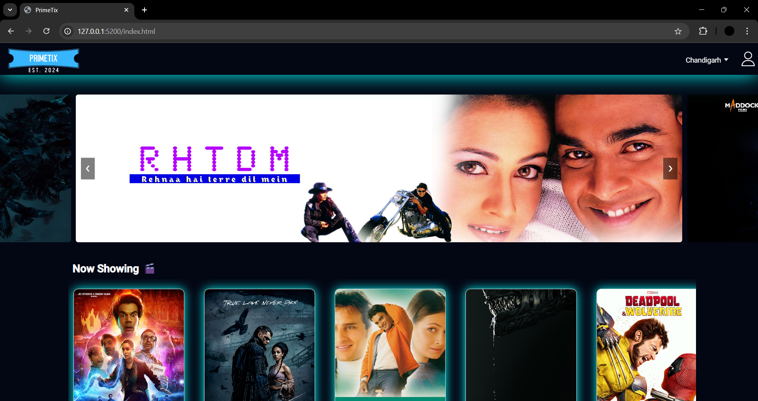
SCREENSHOTS

Slide 12
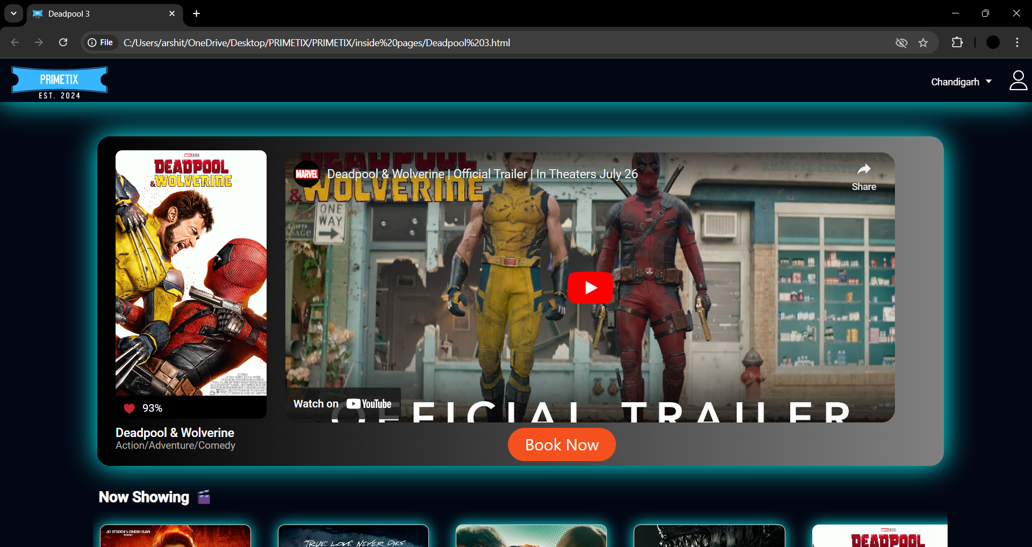
SCREENSHOTS

Slide 13


